Slide 1
Session #6: In-Context Learning
Thursday, Sept 8
CSCI 601.771: Self-supervised Statistical Models

Slide 2
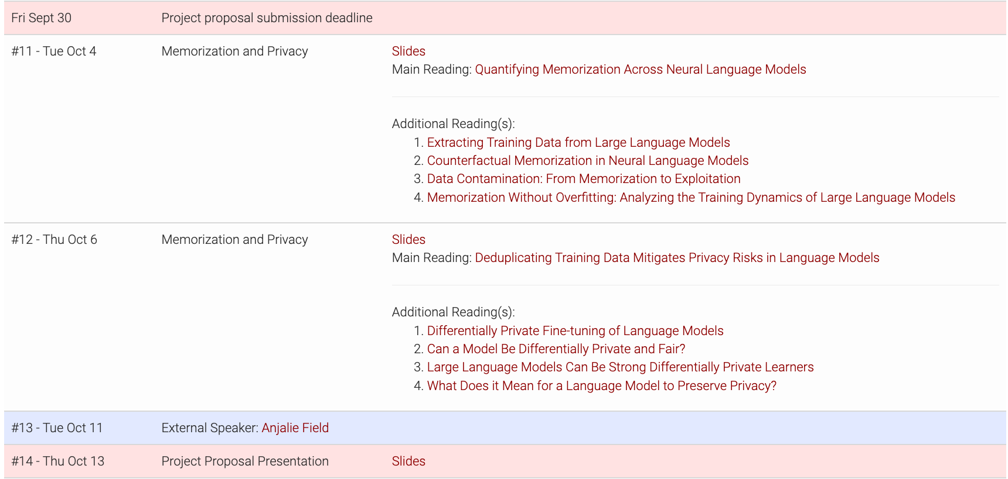
Project Proposals

Slide 3
Project Proposals
Deadline: Friday, Sept 30
Topic: open-ended
Content: a single-paragraph description of what you intend to do (experiments, datasets, methods, etc.)
I will provide feedback on these ideas to help the teams with finding a concrete idea.
Teamwork is optional but encouraged!

Slide 4
Lightening Proposal Presentations
When? Thursday, Oct 13 (the usual class time)
What: each time will present their proposal in a few minutes.

Slide 5
Week's prompt
This would have been a much better paper if ____

Slide 6
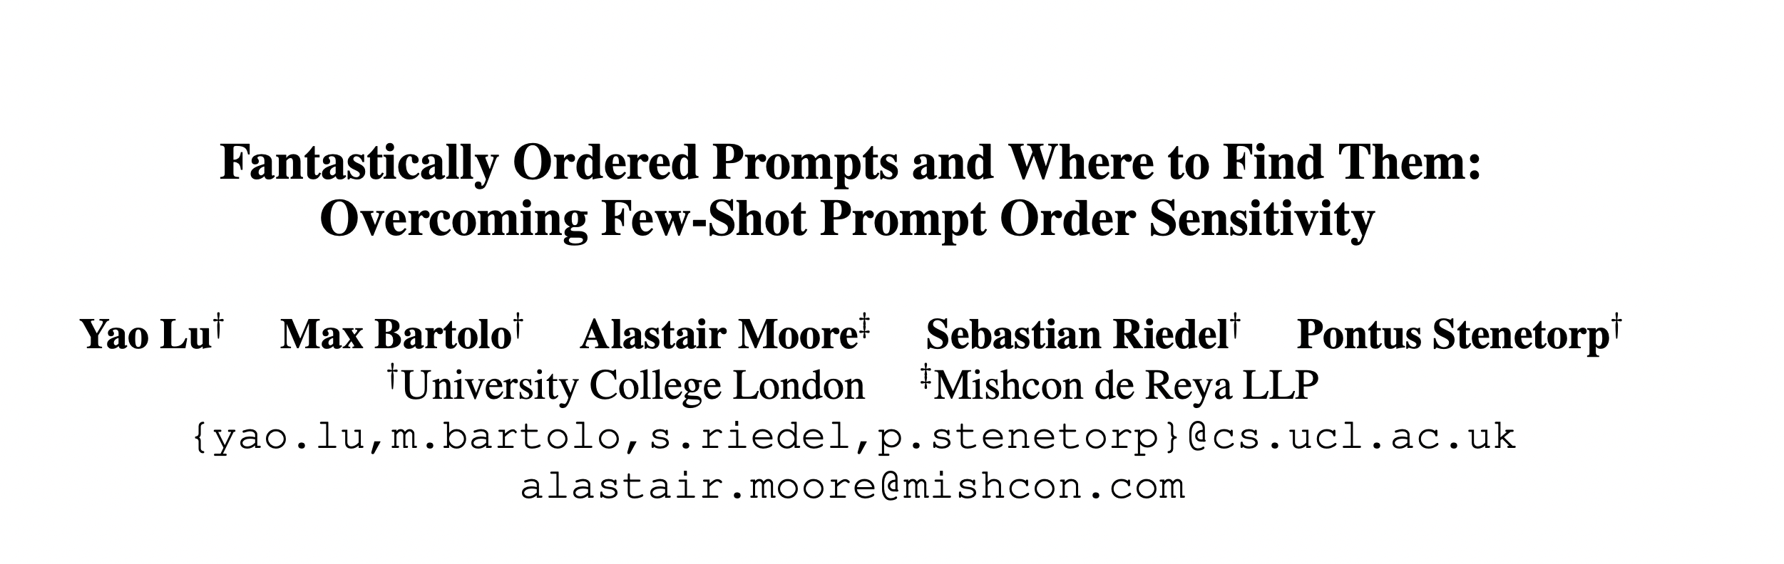
✍️: Aayush Mishra and Lingfeng Shen

Slide 7
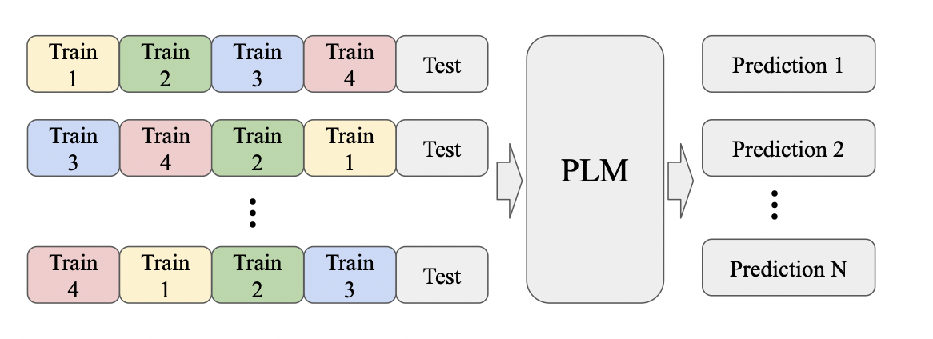
Prompt Order Sensitivity
Take 4 samples, create all 24 permutations, test prediction performance.
Test on variety of tasks (datasets) and models (4 GPT-2, 4 GPT-3 sizes)
✍️: Aayush Mishra and Lingfeng Shen

Slide 8
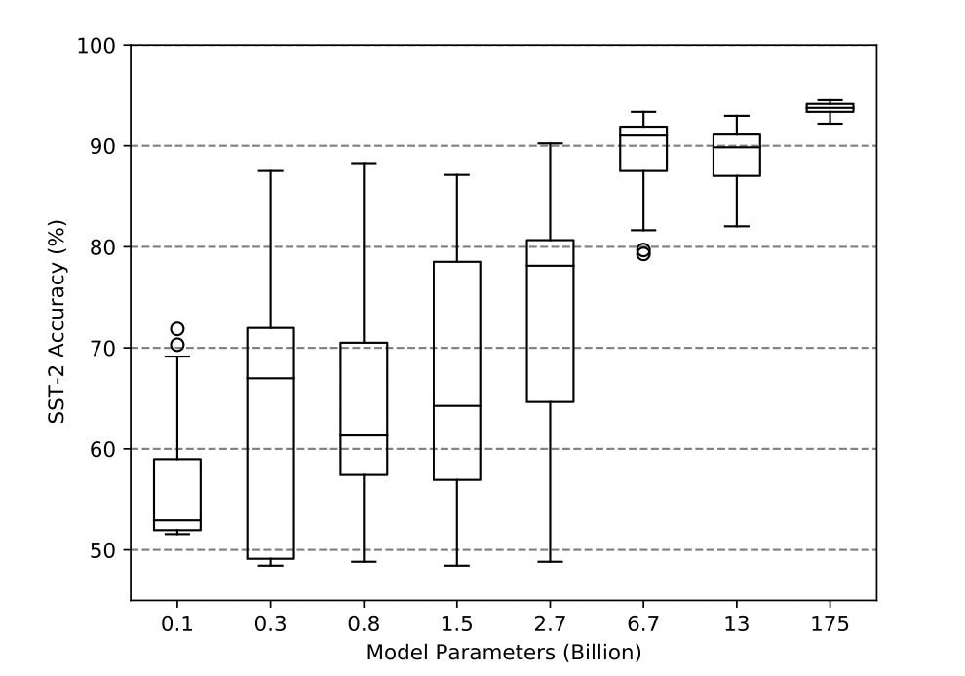
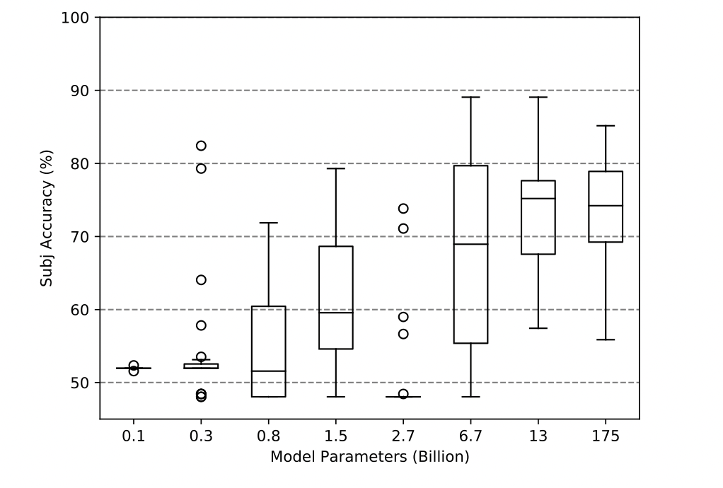
Do Large Language Models really understand prompts well?
Order matters for self-supervised models
Model size matters, but not always
Order does not matter as much for Supervised models¹
✍️: Aayush Mishra and Lingfeng Shen
¹Gao et. al. Making pre-trained language models better few-shot learners. arXiv preprint arXiv:2012.15723

Slide 9
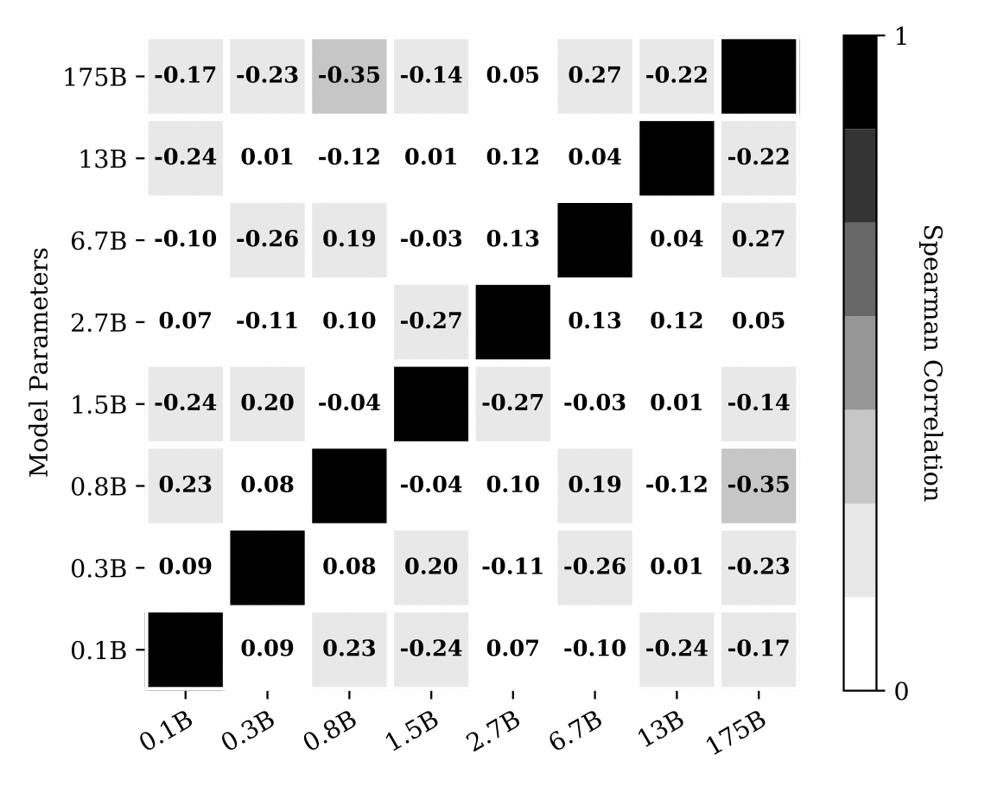
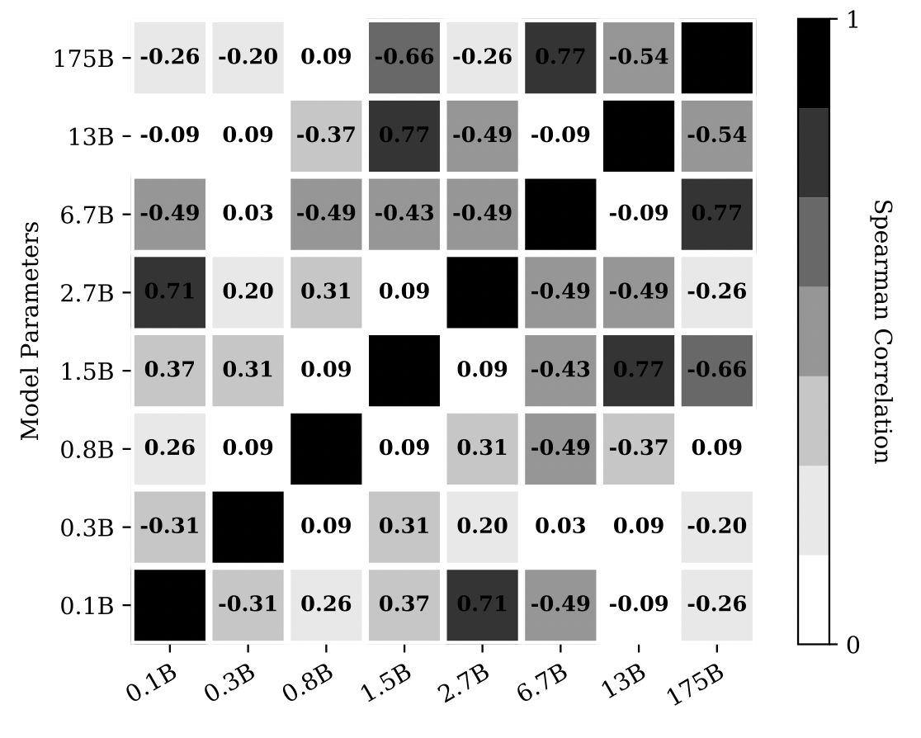
Prompt Design Study
Performance Prompts are not
transferable across models
Label ordering does not matter
✍️: Aayush Mishra and Lingfeng Shen

Slide 10
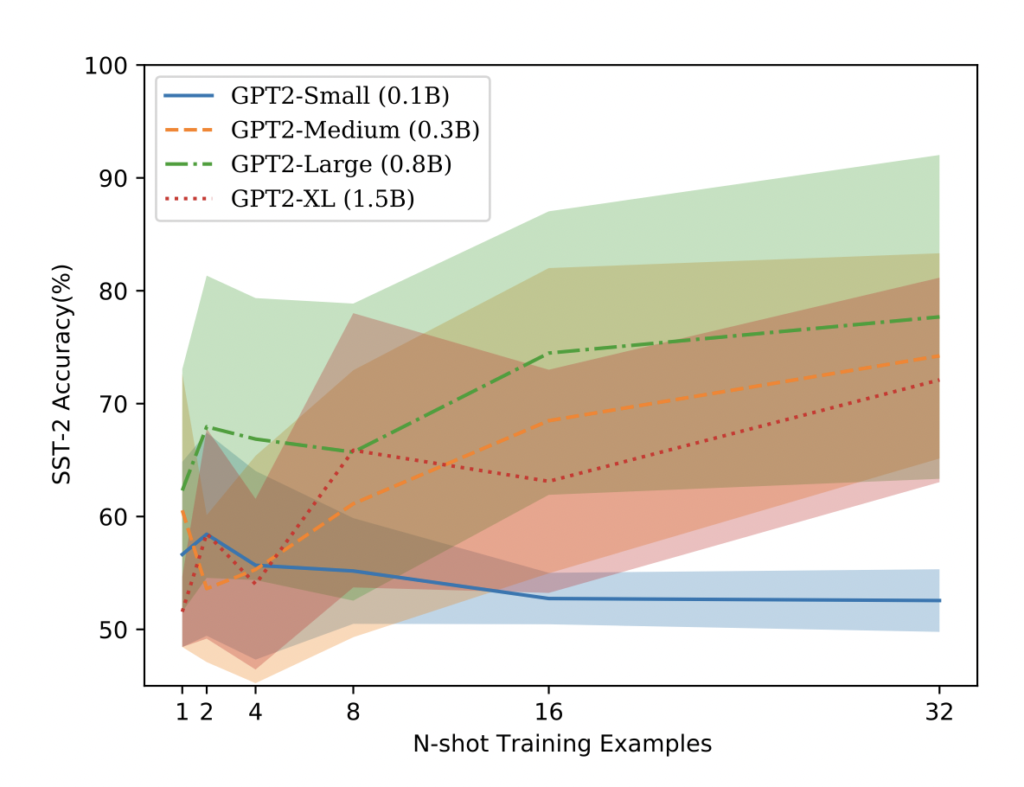
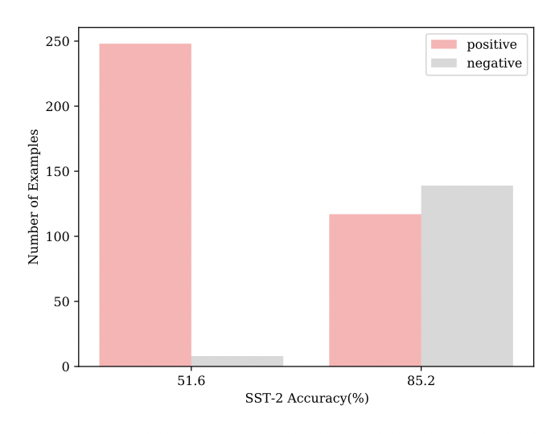
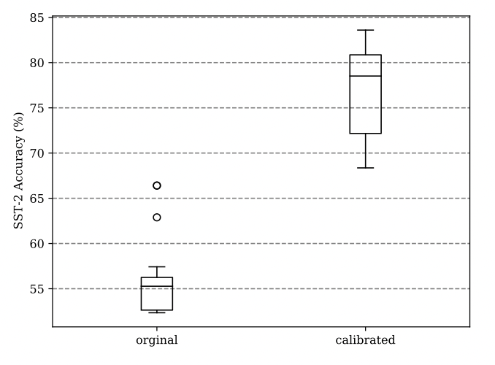
Prompt Design Study
Increasing N does not reduce performance variance much
Failing prompts suffer from unbalanced label distribution
Calibration¹ improves performance but variance stays high
✍️: Aayush Mishra and Lingfeng Shen
¹ Zhao et. al. Calibrate before use: Improving few-shot performance of language models. arXiv preprint arXiv:2102.09690.

Slide 11
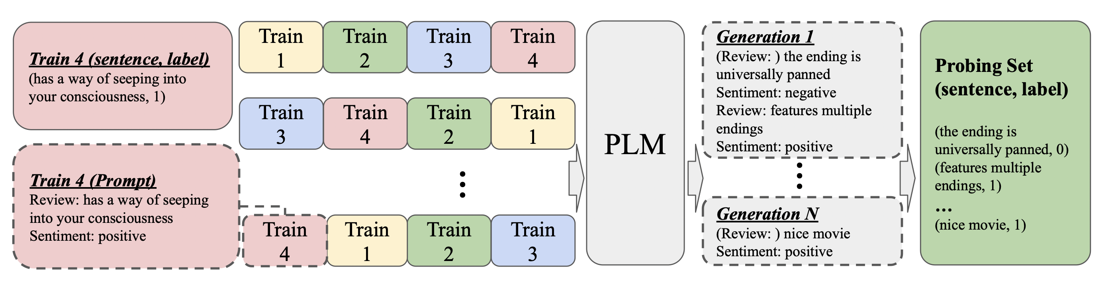
Prompt Engineering
How to automatically generate a ‘probing set’ to find performant prompt orderings?
✍️: Aayush Mishra and Lingfeng Shen

Slide 12
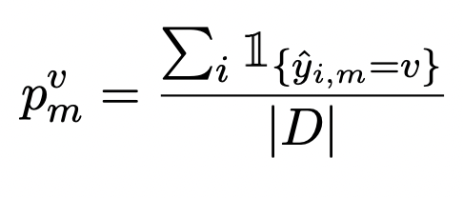
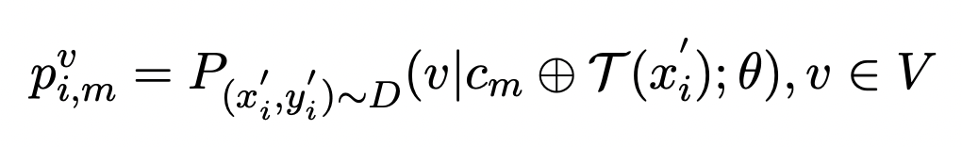
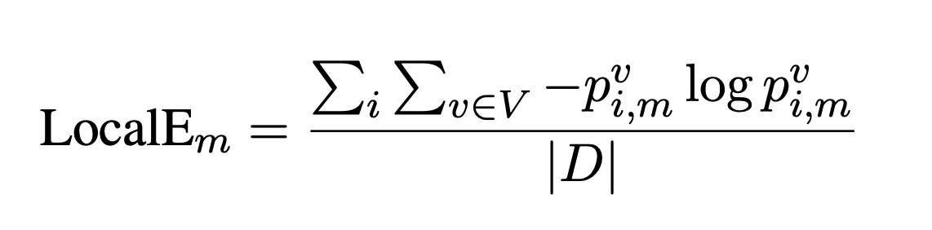
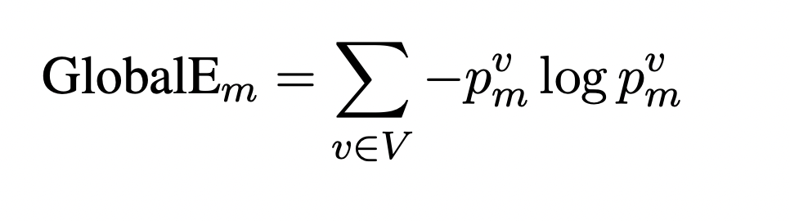
Probing Metrics
For prompts that avoid extremely unbalanced predictions.
To penalize overconfident predictions.
✍️: Aayush Mishra and Lingfeng Shen

Slide 13
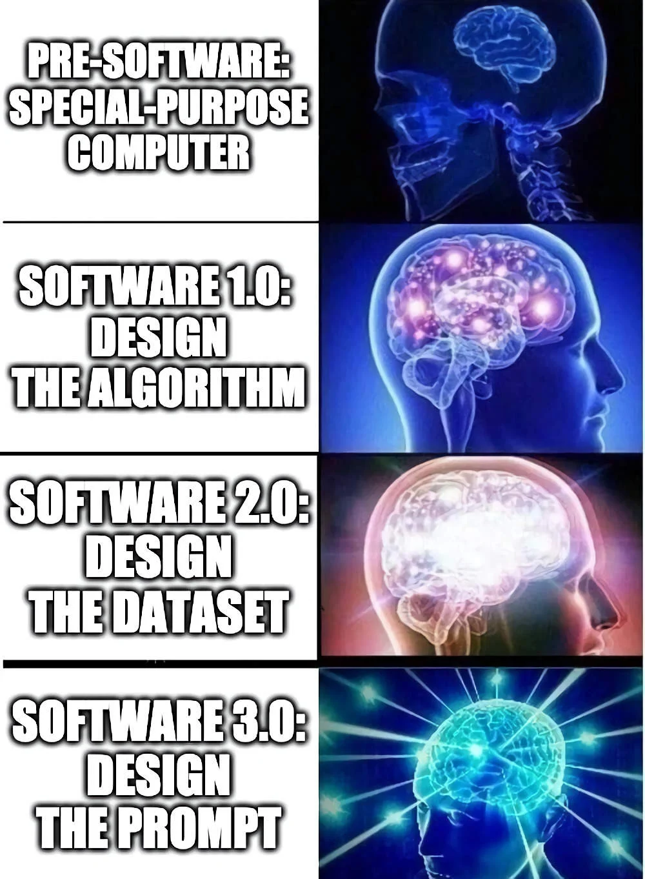
✍️: Aayush Mishra and Lingfeng Shen
https://www.gwern.net/GPT-3

Slide 14
Experiments
Models: GPT-2 (with 0.1B, 0.3B, 0.8B, and 1.5B parameters), GPT-3 (with 2.7B, and 175B parameters)
Benchmarks: Classification dataset : SST-2, SST-5, DBPedia …...
Baselines:
Majority: predict the majority label in the dataset (lower-bound)
Oracle: select the top four orderings based on performance on the dev set (upper-bound)
https://www.gwern.net/GPT-3
✍️: Aayush Mishra and Lingfeng Shen

Slide 15
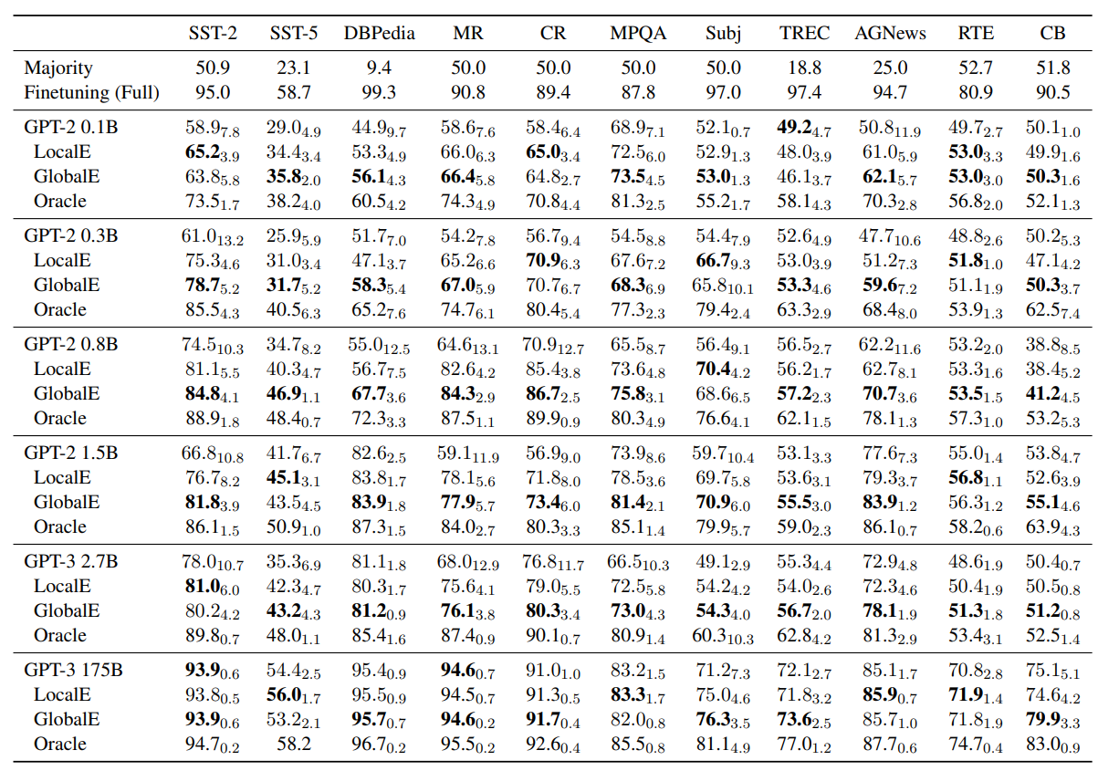
✍️: Aayush Mishra and Lingfeng Shen

Slide 16
Results
Entropy-based probing is effective for performant prompt selection regardless of model size
GlobalE achieves, on average, a 13% relative improvement across the eleven different sentence classification tasks in comparison to without probing.
LocalE provides results slightly inferior to GlobalE, with an average 9.6% relative improvement over the baseline model.
✍️: Aayush Mishra and Lingfeng Shen

Slide 17
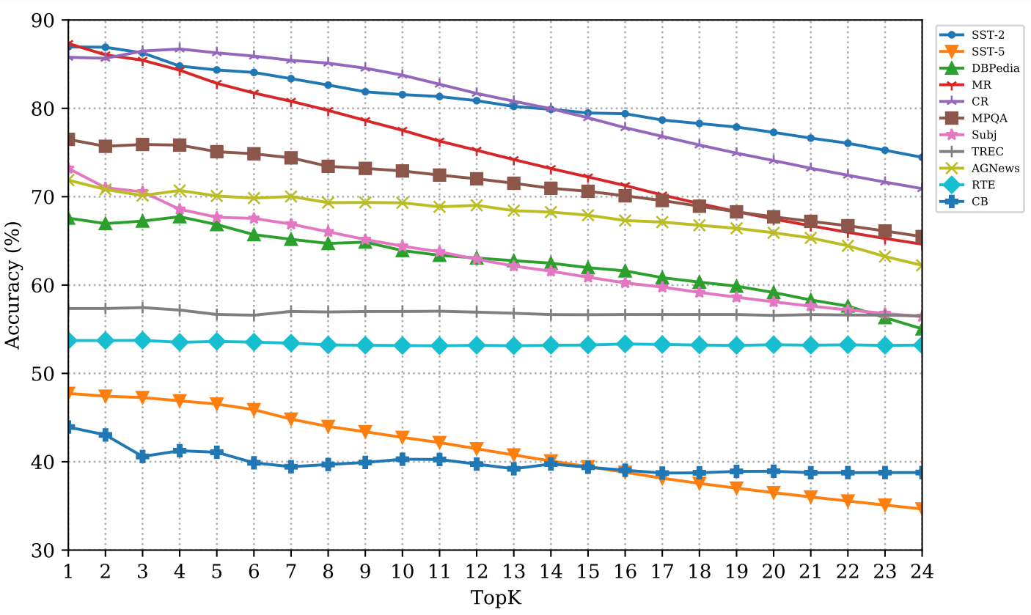
Results
Ranking using Entropy-based probing is robust
✍️: Aayush Mishra and Lingfeng Shen

Slide 18
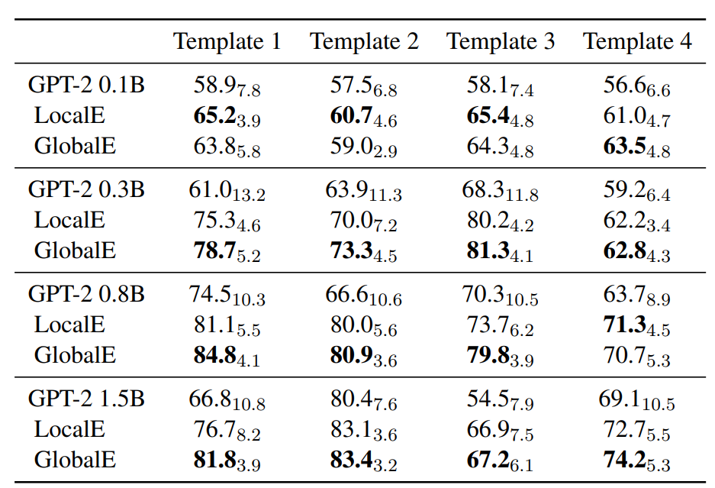
Results
Entropy-based probing is effective across templates
✍️: Aayush Mishra and Lingfeng Shen

Slide 19
Overview
Pointing out a counter-intuitive phenomenon
few-shot prompts suffer from order sensitivity
✍️: Aayush Mishra and Lingfeng Shen

Slide 20
Overview
Pointing out a counter-intuitive phenomenon
few-shot prompts suffer from order sensitivity
Conduct comprehensive empirical analyses from different aspects
tasks, model sizes, prompt templates, samples, and number of training samples.
✍️: Aayush Mishra and Lingfeng Shen

Slide 21
Overview
Pointing out a counter-intuitive phenomenon
few-shot prompts suffer from order sensitivity
Conduct comprehensive empirical analyses from different aspects
tasks, model sizes, prompt templates, samples, and number of training samples.
Propose an effective method to tackle the problem
a probing method that construct an artificial development set.
✍️: Aayush Mishra and Lingfeng Shen

Slide 22
Future directions
Linguistic perspective
Are there any linguistic commonalities in these good orders?
How do these good orders arise?
Does it correlate with some linguistic distributions in the pre-trained corpus?
✍️: Aayush Mishra and Lingfeng Shen

Slide 23
Future directions
Linguistic perspective
Are there any linguistic commonalities in these good orders?
How do these good orders arise?
Does it correlate with some linguistic distributions in the pre-trained corpus?
Mathematical perspective
Does the uncertainty issue really come from biased/over-confident predictions?
Where does the uncertainty come from? (Error of estimated distribution towards ground-truth)
PAC-bayes or something?
✍️: Aayush Mishra and Lingfeng Shen

Slide 24
Cons - Vicky
Unexplored theoretical grounding | Lack of transferability
Prompt ordering affects performance greatly but is not transferable
Why does ordering matter? Why is it not transferable? Is this similar to brute-force
Probing metrics: Each motivation explained, but does not explain why only these two / how these two compare, and reason about their differing performances
Ablations not fully covered
Argument on template invariance: Singled out sentiment analysis that inherently has limited template formats
Lack of coverage on the 11 tasks evaluated: Pointed out sentence-pair tasks, but what about others? Complete breakdown beneficial
Argument on probing to be better than train-devel split: Is it really better than original data, or is the split unfair? (Train set cut to half, expected drop)
General comments
Figure captions can be improved
Fig 1: Lack of description on variation within single sample run
Fig 3: Insufficient description on variance shade
Fig 4/5: Insufficient description on correlation value (small = worse)
Introduce some context earlier for better grounding
Reason for choosing 4-shot (limited by window size)
Each sample run is averaged across 5 subsets, each with 24 permutations
🔎 Vicky Zeng and Aowei Ding

Slide 25
Pros - Aowei
Figures clearly showed that:
models different order of the sample would obtain different performance;
For the same dataset, different models require different prompt ordering to reach a high performance.
Novel strategy for obtaining different prompt set
Achievement : Automatically selecting prompt set. Without using development set
Generating from train set (Limited develop set in few shot).
Global Entropy. Avoid unbalancing,non-performant prompts. Local Entropy. Find the prompt with high ability in differentiating classes.
Considered the situation that not rely on generation samples. Also did experiment with gathering prompt set from the development dataset. Also obtain better performance comparing to Baseline.
🔎 Vicky Zeng and Aowei Ding

Slide 26
Summary: Few-Shot Prompt Order Sensitivity
When primed with a handful of prompts in few-shot learning, changing the order of prompts provided can cause performance to improve from random (50%) to state-of-the-art (90%)¹. This is present across tasks, model sizes, number of prompts, and prompt templates. To optimize this order sensitivity, the paper presents a novel probing method that generates an artificial development set from the language model via sampling of existing data. Entropy statistics is run on this development set to identify the best order permutations, leading to an average of 13% improvement across eleven text classification tasks.
6.7B-parameter GPT-3 for Subject Classification Task
🔎 Vicky Zeng and Aowei Ding

Slide 27
Review: Summary
When primed with a handful of samples in few-shot learning, changing the order of samples provided can cause performance to improve from random (50%) to state-of-the-art (90%)¹. This is present across tasks, model sizes, number of samples, and prompt templates. To optimize this order sensitivity, the paper presents a novel probing method that generates an artificial development set from the language model via sampling of existing data. Entropy statistics is run to identify the best order permutations, leading to an average of 13% improvement across eleven text classification tasks.
6.7B-parameter GPT-3 for Subject Classification Task
🔎 Vicky Zeng and Aowei Ding

Slide 28
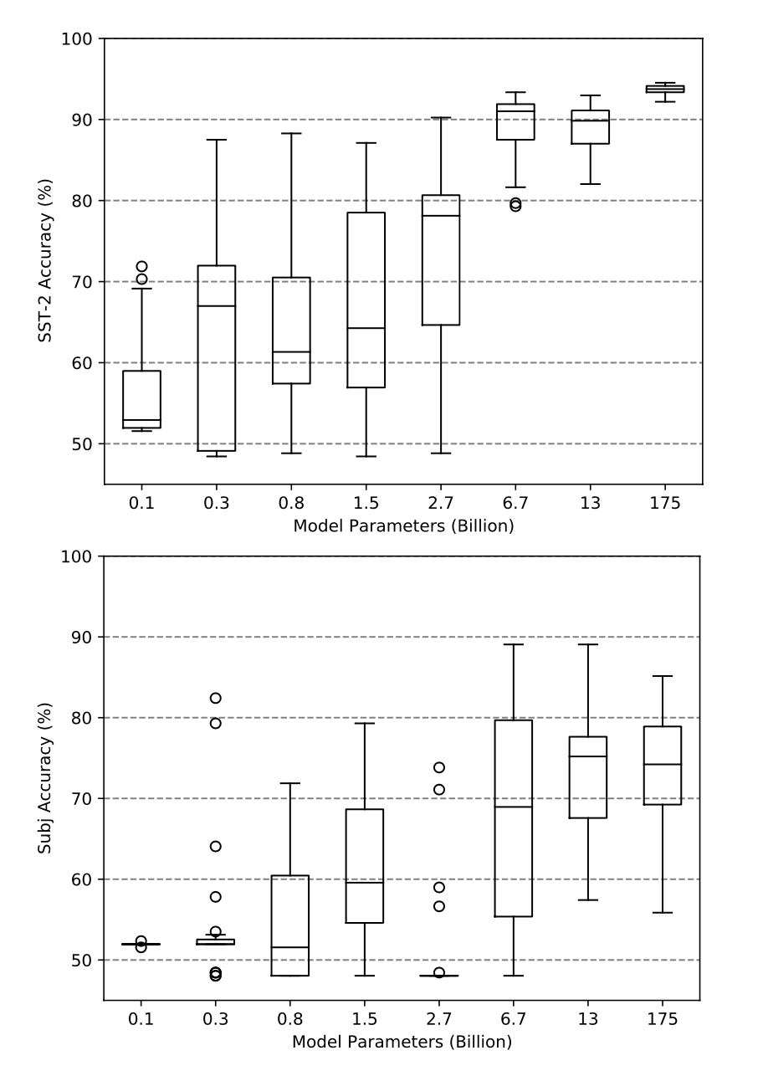
Strength
Figures clearly showed that:
models different order of the sample would obtain different performance;
🔎 Vicky Zeng and Aowei Ding

Slide 29
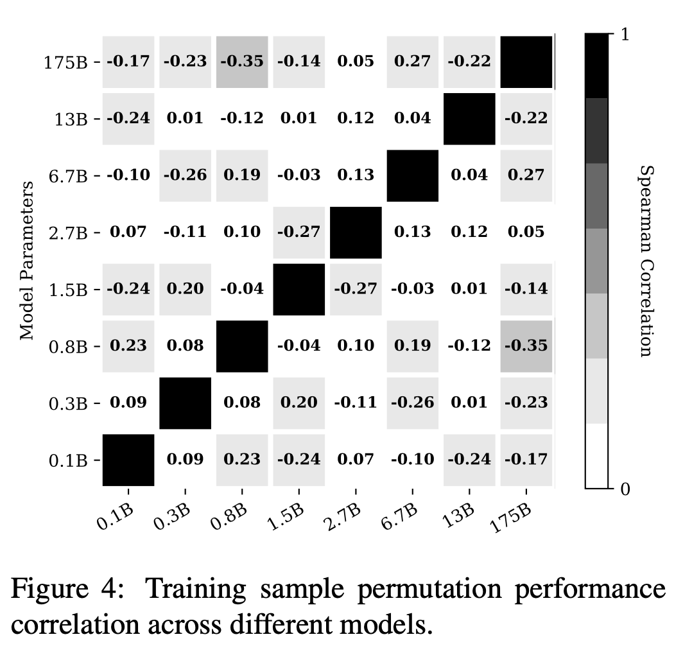
Strength
For the same dataset, different models require different prompt ordering to reach a high performance.
pairwise Spearman’s rank correlation coefficient between the scores.
🔎 Vicky Zeng and Aowei Ding

Slide 30
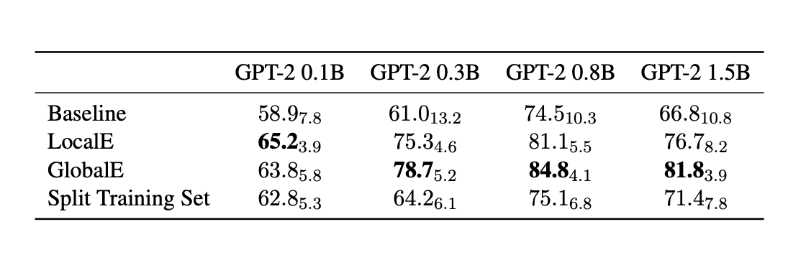
Strength
Novel strategy for obtaining different prompt set
Generating from train set (Limited development set in few shot).
Global Entropy. Avoid unbalancing, non-performant prompts. Local Entropy. Find the prompt with high ability in differentiating classes.
Considered the situation that not relying on generation samples(sufficient development dataset). Also did experiment with gathering prompt set from the development dataset. Also obtain better performance comparing to Baseline.
🔎 Vicky Zeng and Aowei Ding

Slide 31
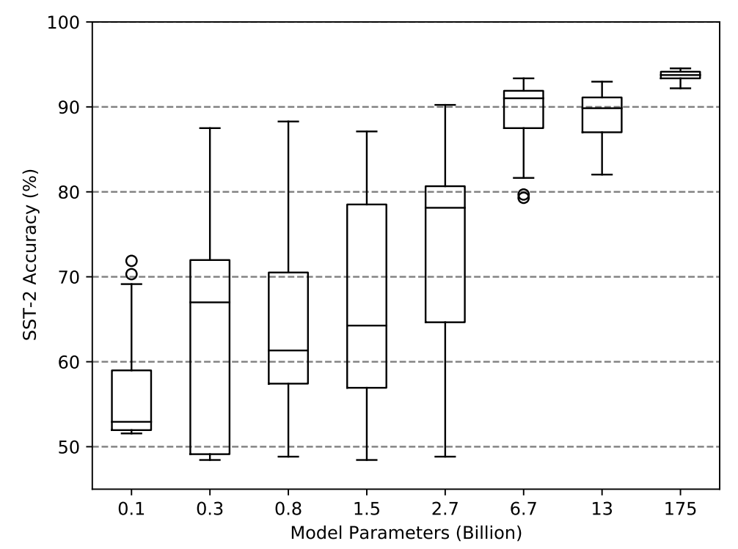
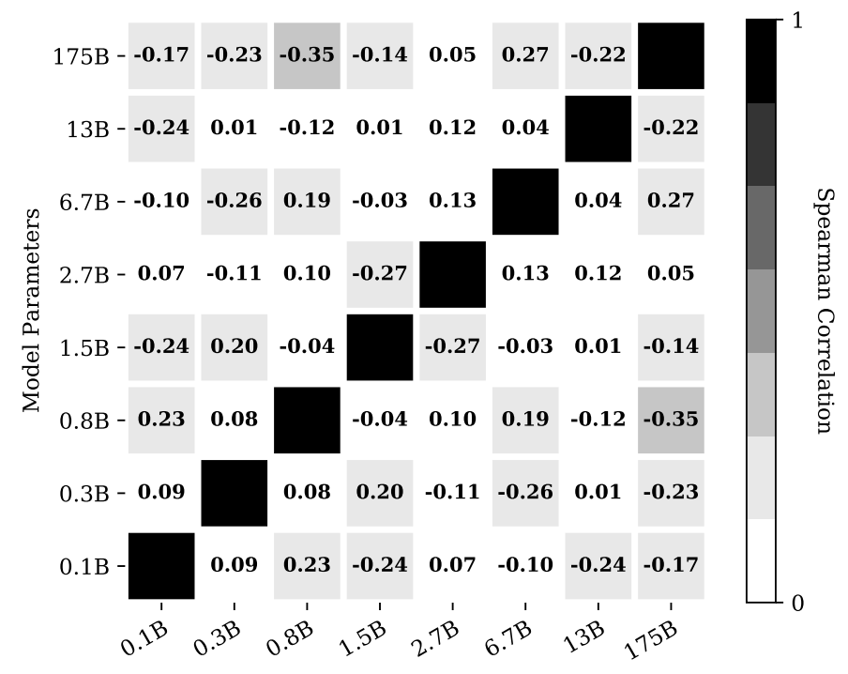
Why? - Theoretical Grounding, Transferability
Why: Why is there order sensitivity / performance difference so great?
Why: Why are optimal prompt permutations not transferable across models?
🔎 Vicky Zeng and Aowei Ding

Slide 32
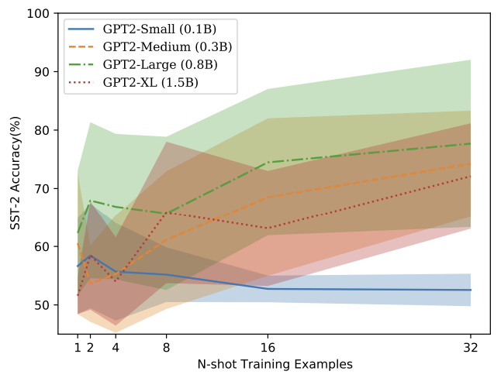
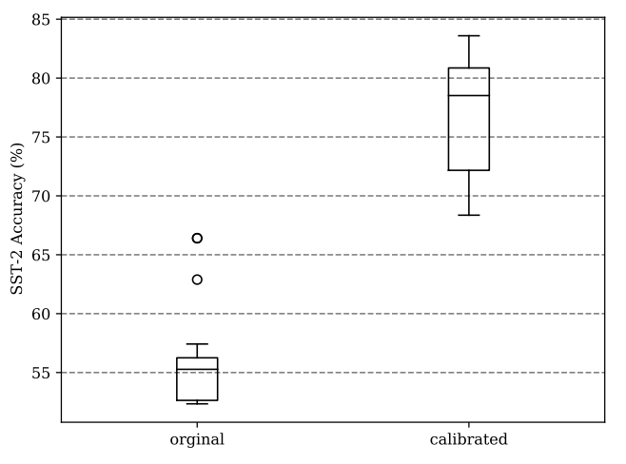
Better ifs - Ablations on Templates, Tasks, Train-Devel Split
GOOD
🔎 Vicky Zeng and Aowei Ding

Slide 33
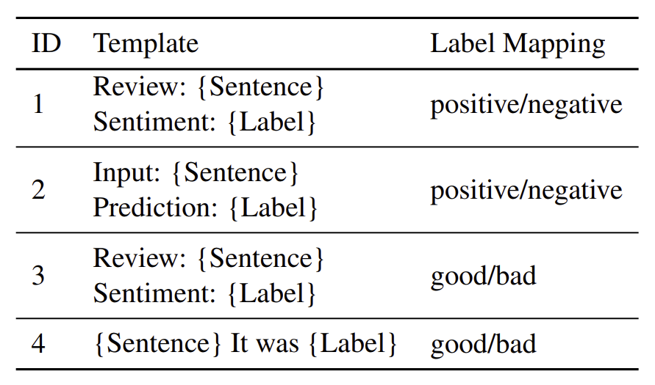

Better ifs - Ablations on Templates, Tasks, Train-Devel Split
Better if: Greater template variation
🔎 Vicky Zeng and Aowei Ding

Slide 34
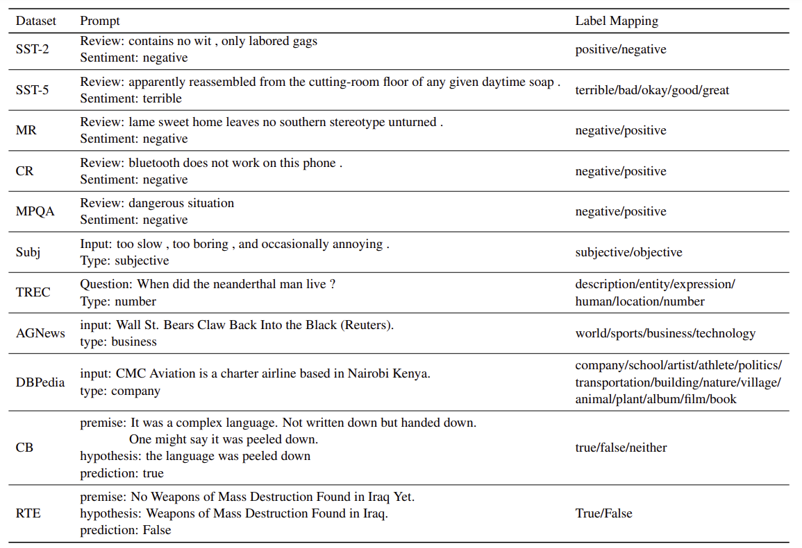
Better ifs - Ablations on Templates, Tasks, Train-Devel Split
Better if:
Greater variety of tasks
Quantitative breakdown of existing tasks
🔎 Vicky Zeng and Aowei Ding

Slide 35
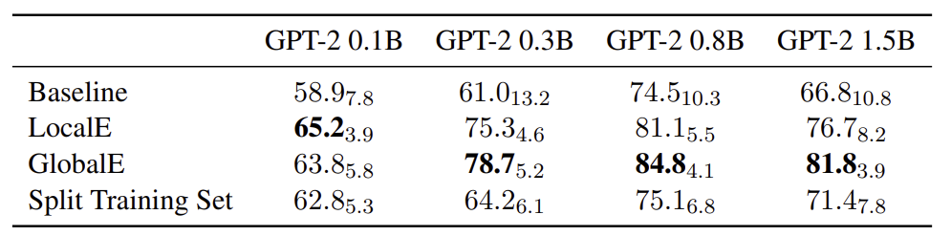
Better ifs - Ablations on Templates, Tasks, Train-Devel Split
Better if: More generous train-devel split
🔎 Vicky Zeng and Aowei Ding

Slide 36
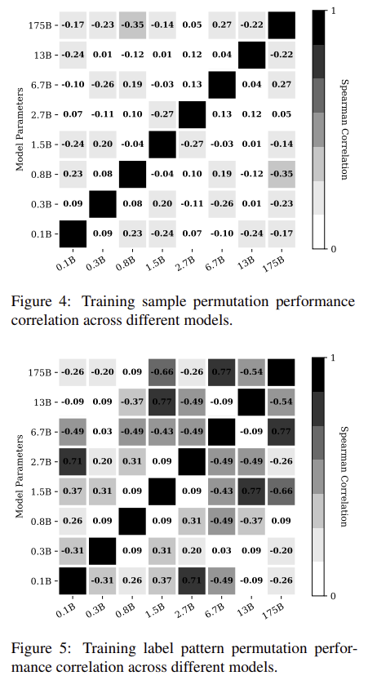
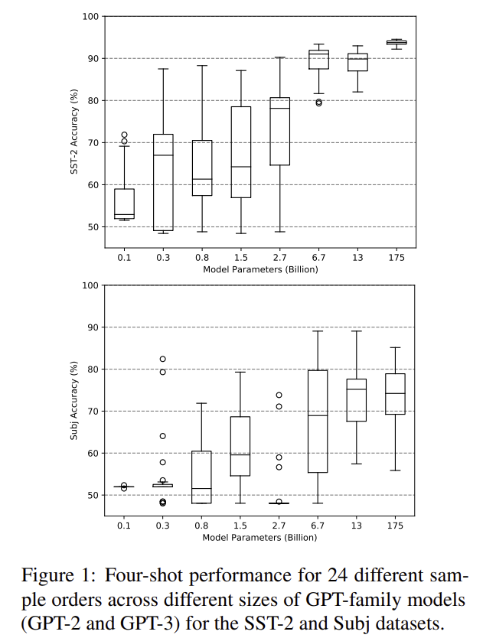
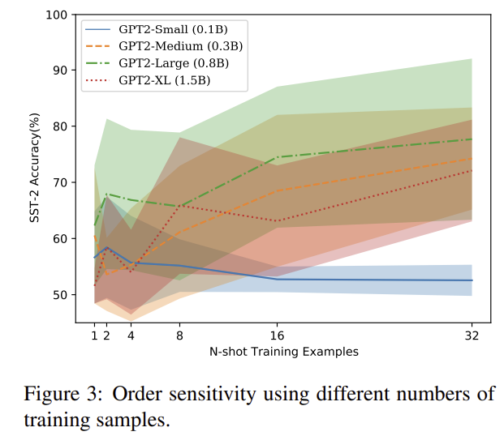
General Improvements -
Figure Captions, Reproducibility
🔎 Vicky Zeng and Aowei Ding

Slide 37
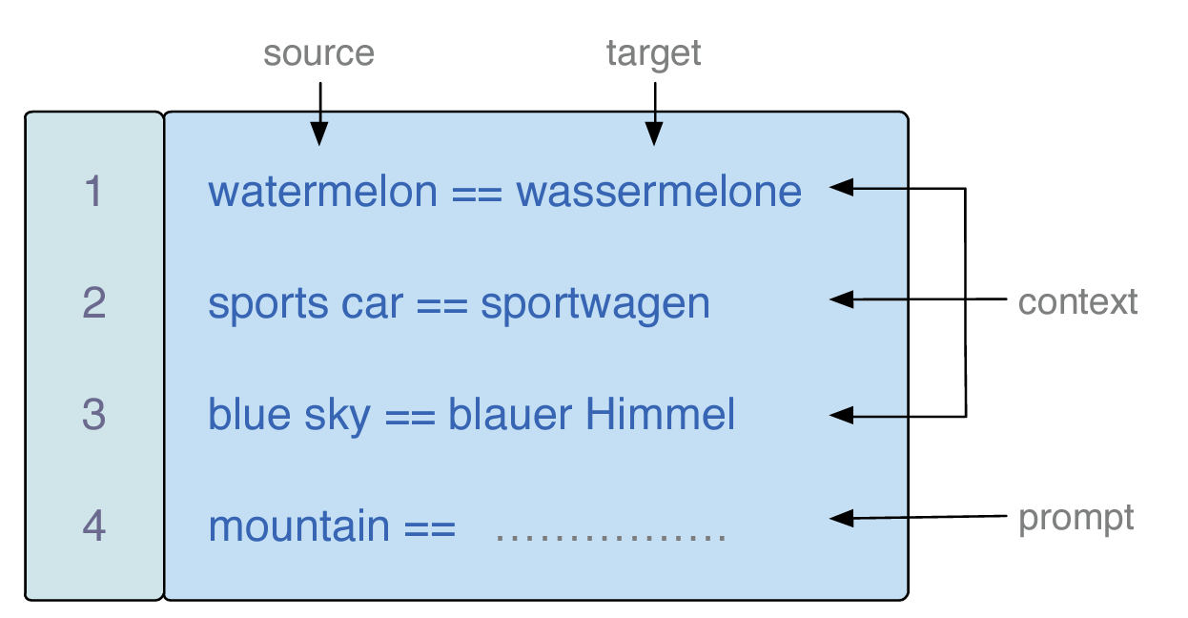
Archaeologist-Previous Work
Question: Where do the examples in context come from?
Training Data?
Which examples to pick?
What's the influence of example selection?
Conclusions: works
🏺: Boyuan Zheng

Slide 38
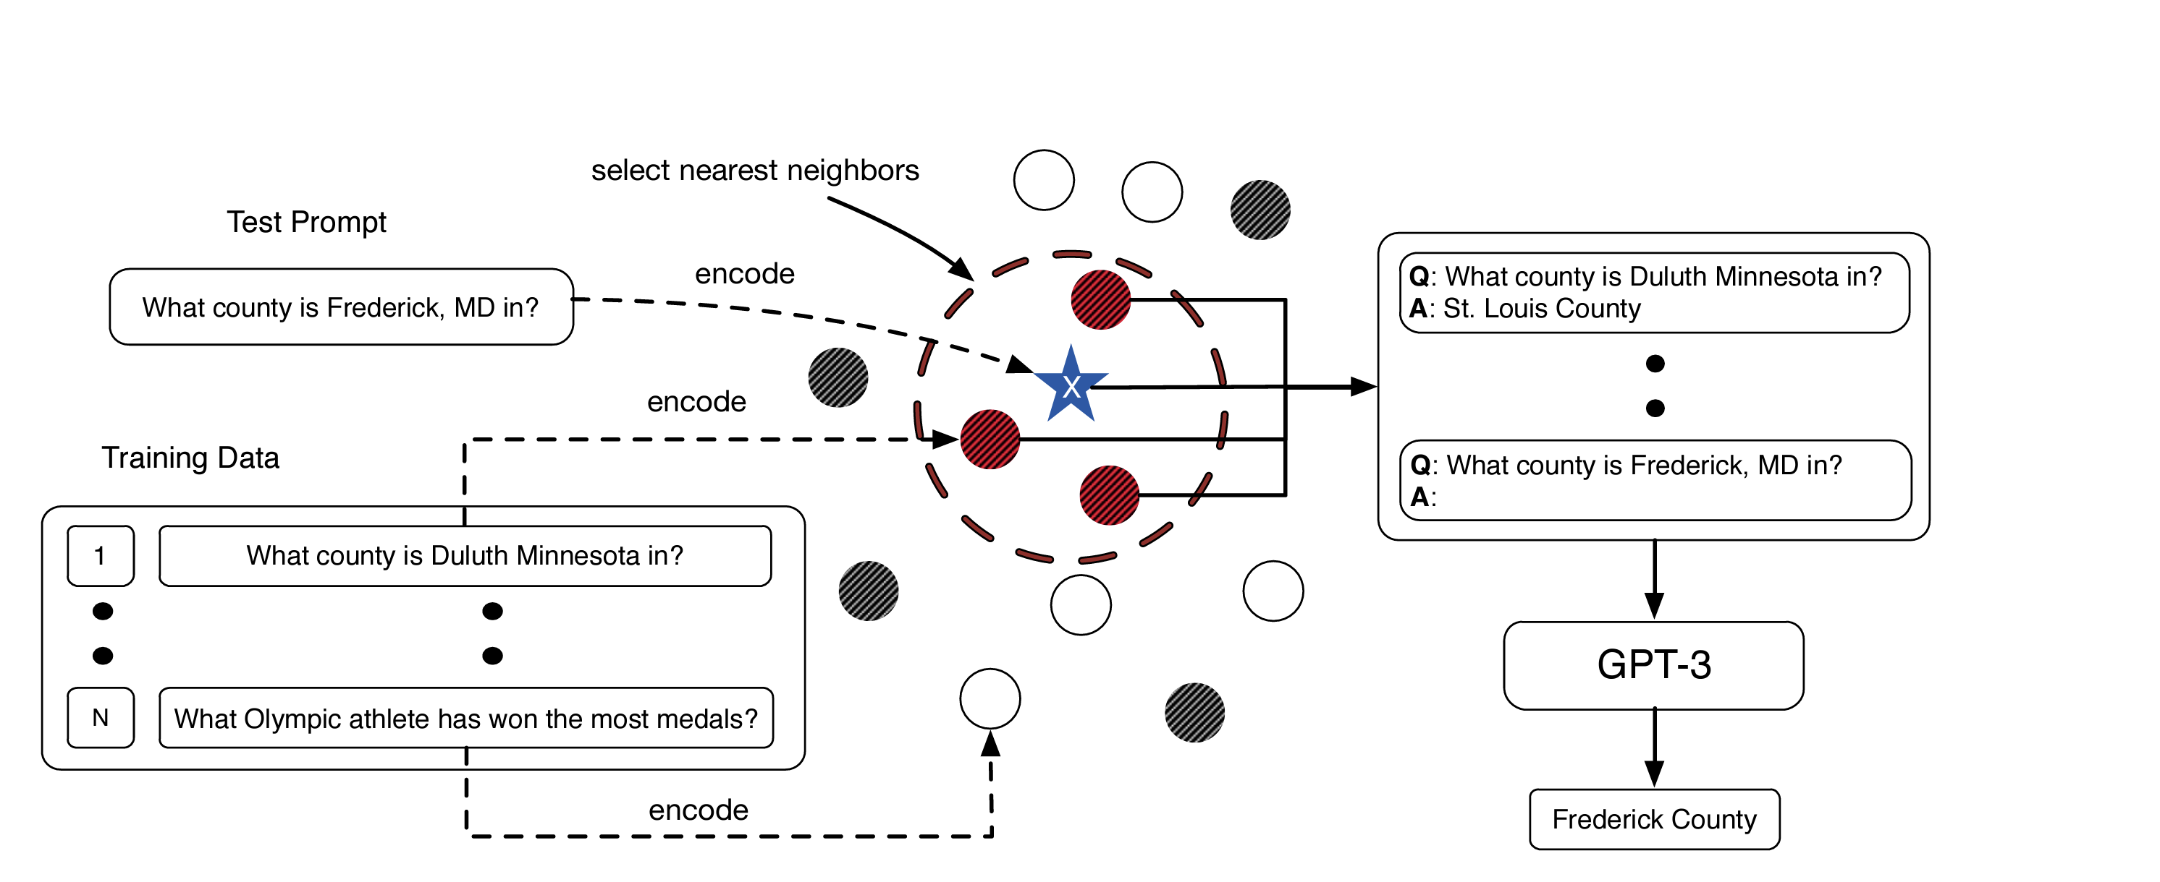
Archaeologist-Previous Work
Paper: What Makes Good In-Context Examples for GPT-3? Liu at el. (2021)
Overview: Non-parametric selection approach to retrieve in-context examples according to their semantic similarity(Euclidean Distance) to the test example.
🏺: Boyuan Zheng

Slide 39
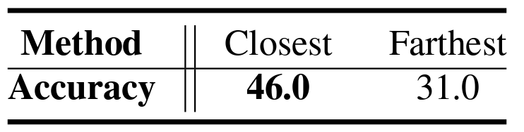
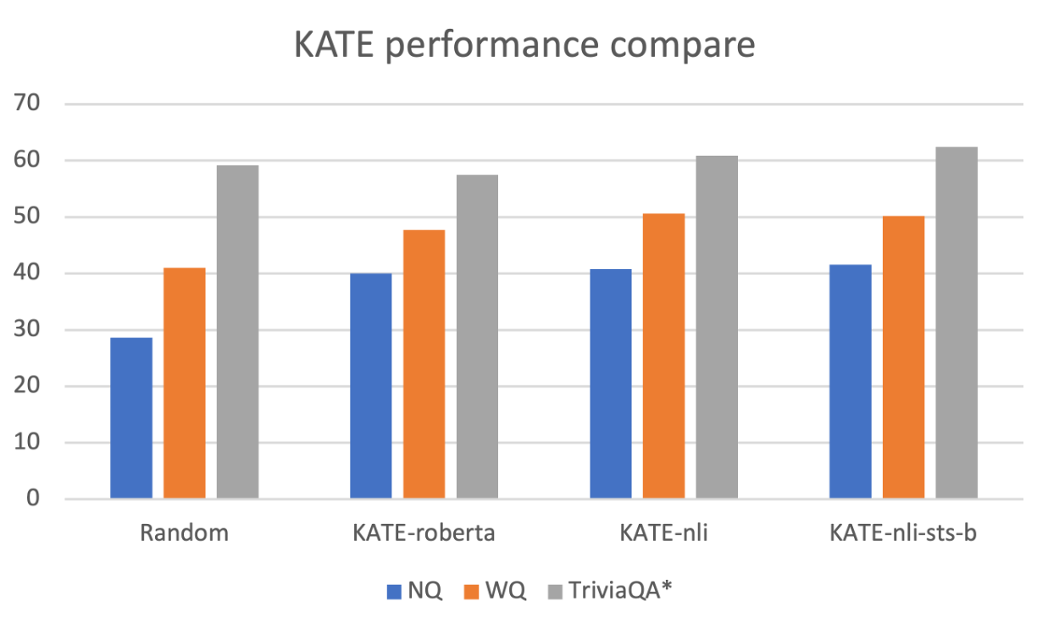
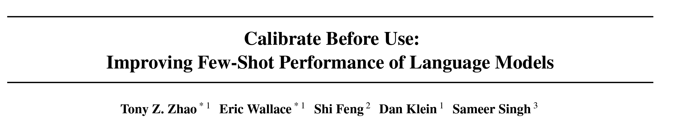
Archaeologist-Previous Work
Impact of In-Context Examples:
Experiment Results:
🏺: Boyuan Zheng

Slide 40
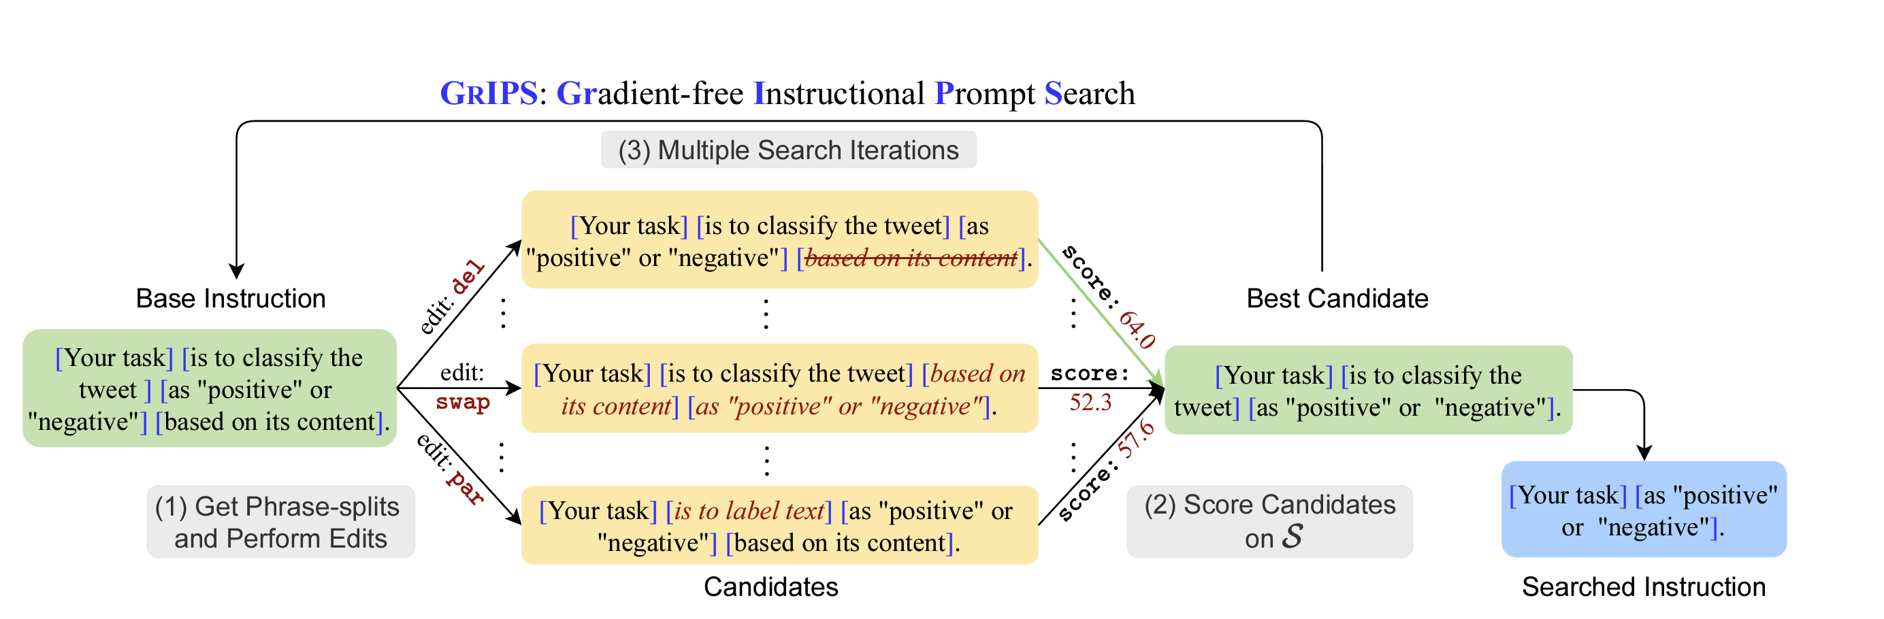
Archaeologist-Subsequent Works
Question:
How about other format of prompts? Instructions, Examples, Discrete Templates?
Is the current Instruction the best?
Is Model's instruction aligned with Human Cognition?
Subsequent Works: GRIPS: Gradient-free, Edit-based Instruction Search for Prompting Large Language Models.
🏺: Boyuan Zheng

Slide 41
Archaeologist-Subsequent Works
Results:
GRIPS works for GPT-2 XL, InstructGPT, in both Instruction-Only and Instruction+Example prompts
GRIPS > Manual Rewritting and Examples-Only Search
Semantics: Semantically incorrehent instructions still works
Wrap Ups: Optimization regarding all kinds of prompts still has research space
Narrow-Down Searching Space?
Better Scoring?
Efficient Sampling?
🏺: Boyuan Zheng

Slide 42
Visionary : Phenomenon
reveal that this sequence-dependent instability is common in a variety of tasks and does not vary with model size and annotated sample size.
the fluctuation range is huge and there is no regularity.
In addition, the authors find the invariance from the changes, and find the rule of label distribution of prediction results caused by different prompt orders.
Accordingly, a PROMPT screening method based on entropy is proposed, and the effect is verified.
🔭: Tianqi Shang and Zhiqing Zhong

Slide 43
Visionary : Phenomenon
Do these good sequences have anything in common in linguistics?
How do these good orders come about?
Will it be associated with some language distributions in the pre-trained corpus?
Why are some validation set data sensitive to the PROMPT sample order?
What data is sensitive and what data is not?
Do sensitive and insensitive data have any linguistic characteristics?
🔭: Tianqi Shang and Zhiqing Zhong

Slide 44
Visionary - Prompt in Industry
Prompt can be useful in...
Few-shot/zero-shot scenario: reduce data labeling cost.
Masked Language Model head -> fewer samples
Parameter-efficient scenario: provide a better application mode for the deployment and service of hyperscale models.
Fixed weights of the pre-trained model
fine-tune prompt with a small number of parameters
🔭: Tianqi Shang and Zhiqing Zhong

Slide 45
Visionary - Prompt in Industry
However,...
Fine tuning is still needed in vertical areas
The model effect depends on the selection of prompts
…
🔭: Tianqi Shang and Zhiqing Zhong

